Slide 1
MACHINE LEARNING PROJECT
Presented by:
Aanchal Soni (B190045EC)

Slide 2

Topic under consideration
Stock Market Prediction Using Machine Learning Algorithms

Slide 3
Overview on Stock Market and this project
Stock market prediction is the act of trying to determine the future value of a company stock or other financial instrument traded on an exchange.
Plotting stock prices along a normal distribution can allow traders to see when the stock is overbought or oversold.
Estimating of the stock market has a high demand for stock customers. Applying all extracted rules at any time is a major challenge to estimate the future stock price with high accuracy. To achieve this goal this project work we will do early prediction of stock market price for a higher accuracy through applying, various Machine Learning Techniques.
Machine learning and deep learning techniques provide better result for prediction by constructing models from datasets collected of Two Sigma organization.
The Project work gives the accurate or higher accuracy model which shows that the model is capable of predicting stock market effectively.

Slide 4
Software:
Google Colab
Libraries:
NumPy
Pandas
Matplotlib
Fastai
Sklearn
Keras
Programming Language: Python
Dataset (from Kaggle):
Two Sigma Organization

Slide 5
1. Linear Regression
2. K-Nearest Neighbor(KNN)
3. Long Short Term Memory
(LSTM)
Features used for stock market prediction:
  Date
  Open
  High
  Low
  Last
  Close
  Total Trade Quantity
  Turnover
Algorithms used for Prediction

Slide 6
Data Set
Data Visualization
WORKFLOW OF THE MODEL
Data Splitting
Test Data
Training Data
Classical approach
Applying classifiers
LR
Performance Evaluation
KNN
LSTM
Output Prediction

Slide 7

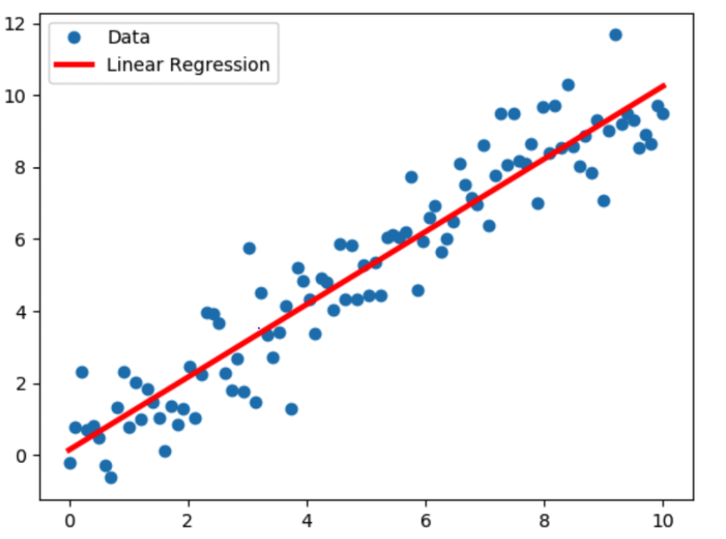
Algorithm-1
Linear regression
Linear regression is an approach for modeling the relationship between a scalar dependent variable ‘y’ and one more independent variable ‘x’

Slide 8
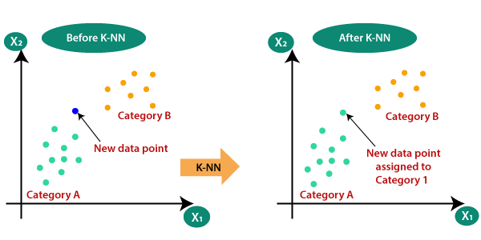
Algorithm-2
K-Nearest Neighbor(KNN) Algorithm
Euclidean distance formula is used in this supervised machine learning algorithm for finding the data nearest to the available categories.

Slide 9
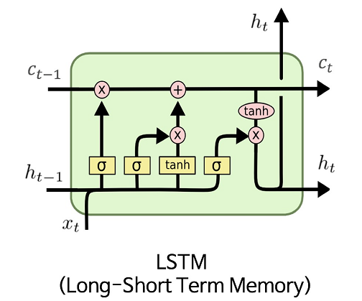
Algorithm-3
Long Short Term Memory
Long Short-Term Memory (LSTM) networks are a type of recurrent neural network capable of learning order dependence in sequence prediction problems.

Slide 10
Accuracy Profile (RMSE)
113.382
ROOT MEAN SQUARE ERROR VALUE
45.239
7.920
Classical
approach
LSTM
KNN
ALGORITHM
LR

Slide 11
CONCLUSION
The dataset consists of 1236 records with the 8 parameters on which stock market depends.
The Classical model shows the RMSE of 45.239.
The ML model Linear Regression shows the RMSE of 113.382.
The ML model k- Nearest Neighbor shows the RMSE of 113.382.
The ML model LSTM shows the RMSE of 7.920.
The main aim of this project was to design and implement Diabetes Prediction Using Machine Learning Methods and Performance Analysis of that methods and it has been achieved successfully.

Slide 12
REFERENCES
https://github.com/sarthak25/Google-Stock-Price-Prediction/blob/master/Prediction.py
https://github.com/souvikb07/Using-News-to-Predict-Stock-Movements-Two-Sigma-/blob/master/Stock_prediction_second_notebook.ipynb
https://youtu.be/OXwZtlcTiuk
https://youtu.be/H6du_pfuznE
https://youtu.be/hOLSGMEEwlI

Slide 13
Thank You!

